Slide 1
Basic Wastewater Math
NMWWA Central Short School
"Fred Ragsdale Memorial" School
Albuquerque, NM
September 8 – 11, 2025

Slide 2
Conversion/Formula Sheet
Corrections
How to use portions of the document

Slide 3
Conversions
Utilizing conversions
Changes units but not magnitude
Essentially multiplication by “1”
Important to include units
3
3
12in
1 ft
1ft__
12 in
=
1
=
=
=
1

Slide 4
1. Convert 3.2 miles to feet
Find the correct conversion factor
(Page 3)
1 mile = 5,280 ft
3.2 miles
1
5,280 ft.
1 mile
x
=
16,896 ft.

Slide 5
2. 3.2 acres to sq.ft.
Find the correct conversion factor
(Page 1)
1 acre = 43,560 ft²
3.2 acres
1
43,560 ft.²
1 acres
x
=
139,392 ft.²

Slide 6
3. 678,754 cu.ft. to acre-ft.
Find the correct conversion factor
(Page 1)
1 acre-ft = 43,560 ft³
678,754 ft³
1
1 ac-ft__
43,560 ft.³
x
=
15.58 ac-ft.

Slide 7
4. 3.7 MGD to gpm
Find the correct conversion factor
(Page 3)
1 MGD = 694.4 gpm
3.7 MGD
1
694.4 gpm
1 MGD
x
=
2,569.3 gpm

Slide 8
5. 1,250 gpm to cfs
Find the correct conversion factor
(Page 3)
1 ft³/sec = 449 gpm
1,250 gpm
1
1 ft³/sec_
449 gpm
x
=
2.78 ft³/sec

Slide 9
6. 0.9 cfs to MGD
Find the correct conversion factor
(Page 3)
1 ft³/sec = 0.6463 MGD or 1 MGD = 1.547 cfs
0.9 ft³/sec
1
0.6463 MGD
1 ft³/sec
x
=
0.58 MGD

Slide 10
7. 768 gpm to acre-ft/day
Find the correct conversion factor
(Page 3)
1 MGD = 3.07 acre-ft/day and 1 MGD = 694.4gpm
768 gpm
1
1 MGD__
694.4 gpm
3.07ac-ft/day
1 MGD
x
x
=
3.4 ac-ft/day

Slide 11
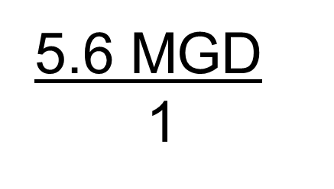
8. 5.6 MGD to cfs
Find the correct conversion factor
(Page 3)
1 ft³/sec = 0.6463 MGD or 1 MGD = 1.547 cfs
5.6 MGD
1
1 ft³/sec___
0.6463 MGD
x
=
8.66 ft³/sec
1.547 ft³/sec
1 MGD
x
=
8.66 ft³/sec

Slide 12
9. 25ºC to ºF
Find the correct formula
(Page 10)
°F = (°C x 1.8) + 32
(25ºC
x
1.8)
+
32
=
77⁰F

Slide 13
10. 90ºF to ºC
Find the correct formula
(Page 10)
(°F – 32) x (0.556) (corrected)
(90ºF
-
32)
x
0.556
=
32.2⁰C

Slide 14
11. Determine the surface area (exposed water area) of a rectangular clarifier, in sq. ft., if the clarifier is 74 feet in length and 32 feet in width.
Find the correct formula (Page 4)

Slide 15
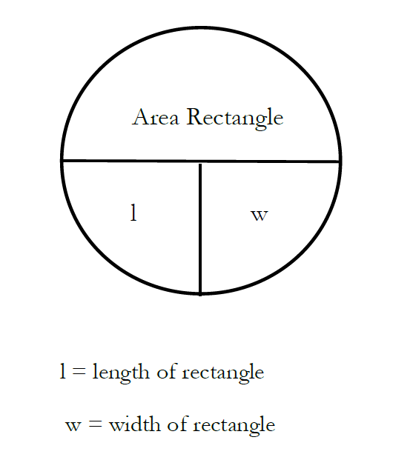

Slide 16
Number 11 Calculation
Length (l) x Width (w)
74 ft.
x
32 ft.
=
2,368 ft²

Slide 17
12. A circular clarifier has a diameter of 72 feet and a depth of 31 feet. Determine the surface area (exposed water area) of the clarifier in sq. ft.
Find the correct formula (Page 4)

Slide 18
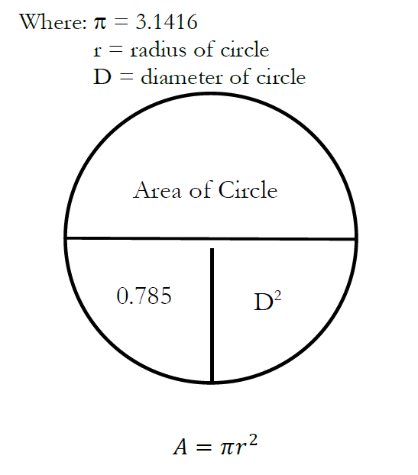
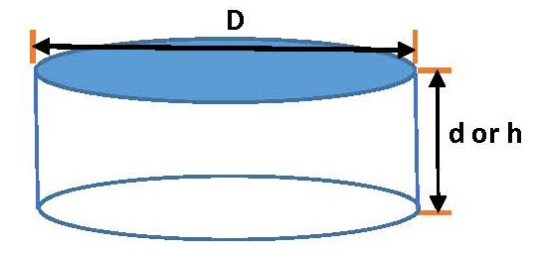

Slide 19
Number 12 Calculation
0.785D²
0.785 x D x D
0.785
x
72 ft.
x
72 ft.
=
4,069 ft²

Slide 20
13. A trickling filter is 58 feet in diameter and has a media depth of 6 feet. Determine the surface area of the media of the trickling filter, in sq. ft.
Find the correct formula (Page 4)

Slide 21
Number 13 Calculation
0.785D²
0.785 x D x D
0.785
x
58 ft.
x
58 ft.
=
2,641 ft²

Slide 22
14. A pond has a width of 380 feet and a length of 540 feet. Determine the surface area of the pond in acres.
Find the correct formula (Page 9)
A = [(L) x (W)]/ (43,560 ft²/ac)

Slide 23

Number 14 Calculation
(Length (l) x Width (w))/(43,560 ft²/ac)
x
(43,560 ft²/acre)
(540 ft.
380 ft.)
÷
=
4.7 acres

Slide 24
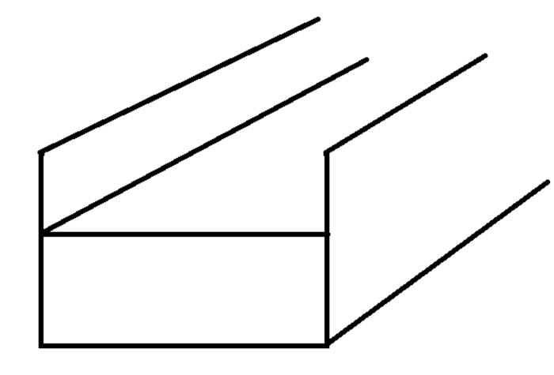
15. Determine the cross-sectional area, in sq. ft., of the flow in a grit channel which is 2.5 feet in width and flowing to a depth of 1 foot, 3 inches.
Find the correct formula (Page 4)

Slide 25
Number 15 Calculation
Length (l) x Width (w)
Step 1 is to convert to the same units.
1 ft. 3 inches = 1.25 ft.
2.5 ft.
x
1.25 ft.
=
3.1 ft²

Slide 26
16. Determine the cross-sectional area, in square inches, of a pipe which is 18 inches in diameter.
Find the correct formula (Page 4)

Slide 27
Number 16 Calculation
0.785D²
0.785 x D x D
0.785
x
18 in.
x
18 in.
=
254.34 sq.in.

Slide 28
17. A rectangular clarifier is 58 feet in length, 24 feet in width, and 18 feet in depth. Determine the volume in cubic feet.
Find the correct formula (Page 4)

Slide 29
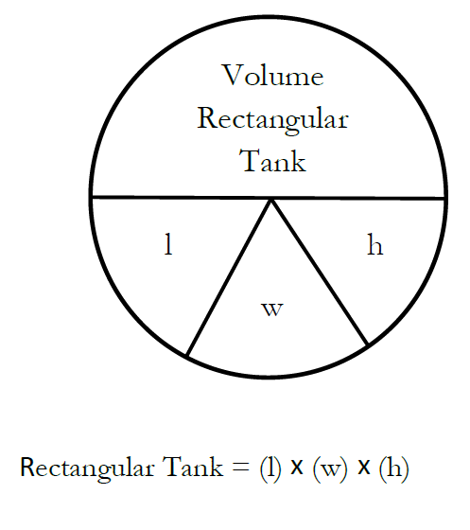
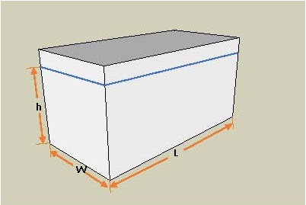

Slide 30
Number 17 Calculation
Length (l) x Width (w) x Height (h)
58 ft.
x
24 ft.
x
18 ft.
=
25,056 ft³

Slide 31
18. A rectangular clarifier is 62 feet in length, 31 feet in width, and 24 feet in depth. Determine the volume in gallons.
Find the correct formula (Page 4)

Slide 32
Number 18 Calculation
Length (l) x Width (w) x Height (h)
Cubic feet must be converted to gallons.
62 ft.
x
31 ft.
x
24 ft.
=
46,128 ft³
46,128 ft³
1
7.48 gals
1 ft³
x
=
345,037 gals

Slide 33
19. A circular clarifier is 71 feet in diameter and has a depth of 22 feet. Determine the volume of the clarifier in cubic feet.
Find the correct formula (Page 4)

Slide 34
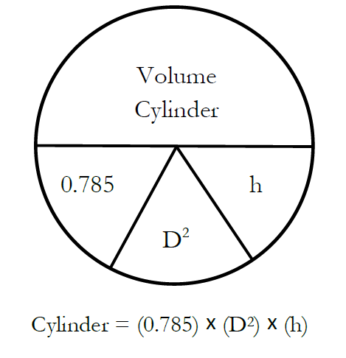

Slide 35
Number 19 Calculation
(0.785) x (D²) x (h)
0.785 x D x D x h
0.785
x
71 ft.
x
71 ft.
x
22 ft.
=
87,058 ft³

Slide 36
20. A circular clarifier is 64 feet in diameter and a depth of 22 feet. Determine the volume of the clarifier in million gallons.
Find the correct formula (Page 4)

Slide 37
Number 20 Calculation
(0.785) x (D²) x (h)
0.785 x D x D x h
Cubic feet must be converted to million gallons
0.785
x
64 ft.
x
64 ft.
x
22 ft.
=
70,738 ft³
70,738 ft³
1
x
7.48 gals
1 ft³
x
1 MG_____
1,000,000 gals
=
0.53 MG

Slide 38
21. A pond has a width of 272 feet, a length of 388 feet, and a depth of 6 feet. Determine the volume of the pond in cubic feet.
Find the correct formula (Page 4)

Slide 39
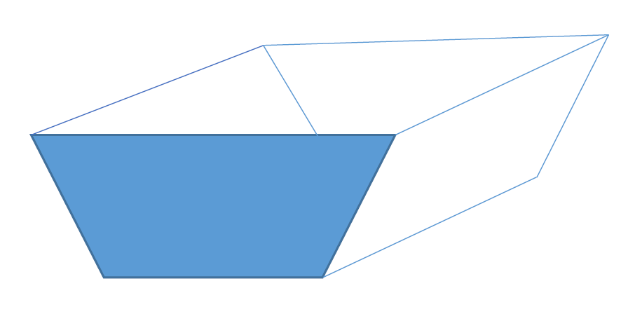
Typical shape of ponds but for basic math only the surface area will be calculated.

Slide 40
Number 21 Calculation
Length (l) x Width (w) x Height (h)
x
=
633,216 ft³
388 ft.
272 ft.
6 ft.
x

Slide 41
22. A pond has a width of 450 feet, a length of 675 feet, and a depth of 5 feet. Determine the volume of the pond in acre-feet.
Find the correct formula (Page 4 and
Page 1)

Slide 42
Number 22 Calculation
Length (l) x Width (w) x Height (h)
Cubic feet must be converted to acre-ft
x
x
=
1,518,750 ft³
675 ft.
450 ft.
5 ft.
1,518,750 ft³
1
1 acre-foot
43,560 ft³
x
=
34.87 ac-ft

Slide 43
23. A grit channel is 24 feet in length and a stick that has been dropped into the channel travels the length of the channel in 32 seconds.
Determine the velocity of flow in the channel.
Find the correct formula (Page 5)
V = (d)/(T)
24 ft__
32 sec
=
0.75 ft/sec

Slide 44

24. Determine the flow rate, in cfs, in a channel that is 3 feet in width and flowing at a depth of 2 feet, and the velocity of flow is 2.0 feet per second.
Find the correct formula (Page 5)
Q = (w) x (d) x (V)

Slide 45
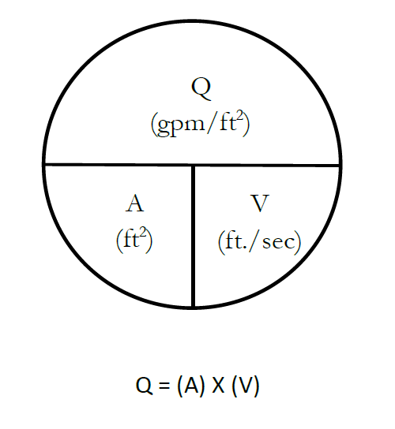
Page 4
ft³/sec

Slide 46
Number 24 Calculation
Q = (w) x (d) x (V)
3 ft.
x
x
2 ft./sec
2 ft.
=
12 ft³/sec

Slide 47
25. Determine the flow rate, in million gallons per day, in a channel that is 2 feet in width, 2 feet in depth, flowing half-full at a velocity of 0.9 feet per second.
Find the correct formula (Page 5)
Q = (w) x (d) x (V)

Slide 48
Number 25 Calculation
Q = (w) x (d) x (V)
Cubic feet/sec must be converted to
MGD
2 ft.
x
1 ft.
x
0.9 ft/sec
1.8 ft³/sec
=
1.8 ft³/sec
1
0.646 MGD
1 ft³/sec
x
=
1.16 MGD

Slide 49
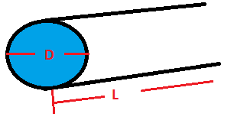
26. An 18-inch pipe is flowing full at a velocity of 2.1 feet per second. Determine the flow rate in cubic feet per second.
Find the correct formula (Page 5)
Q = (0.785) x (D)² x (V)
V

Slide 50
Number 26 Calculation
Q = (0.785) x (D)² x (V)
Q = 0.785 x D x D x V
18 inches = 1.5 ft.
0.785
x
1.5 ft.
2.1 ft./sec
1.5 ft.
x
x
=
3.71 ft³/sec

Slide 51
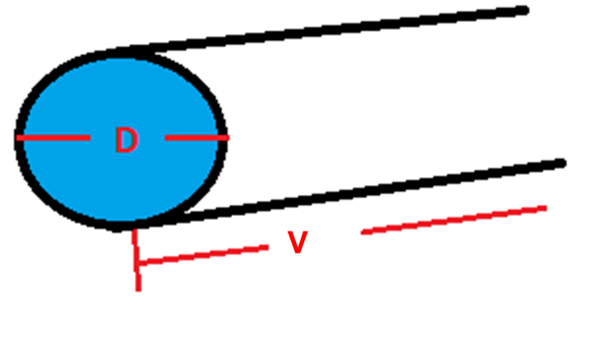
27. A 24-inch pipe is flowing full at a velocity of 1.1 feet per second. Determine the flow rate in gallons per minute.
Find the correct formula (Page 5)
Q = (0.785) x (D)² x (V)

Slide 52
Number 27 Calculation
Q = (0.785) x (D)² x (V)
Q = 0.785 x D x D x V
24 inches = 2 ft.
0.785
x
2 ft.
2 ft.
x
x
1.1 ft./sec
=
3.45 ft³/sec
3.45 ft³/sec
1
449 gpm__
1 ft³/sec
x
=
1,549 gpm

Slide 53

28. Determine the detention time, in hours, for a rectangular clarifier that is 68 feet in length, 27 feet in width, and 18 feet in depth, if the flow into the clarifier is 2.6 MGD.
Find the correct formula (Page 11)

Slide 54
Number 28 Calculation
68 ft
x
27 ft.
x
18 ft.
=
33,048 ft³
33,048 ft³
1
7.48 gal
1 ft³
247,199 gal
x
=
2.6 MGD = 2,600,000 gal/day

Slide 55
Number 28 Calculation (cont.)
247,199 gal
x
24 hr./day
=
2.3 hrs.
2,600,000 gal/day

Slide 56
29. A rectangular clarifier is 65 feet in length, 23 feet in width, and has an operating depth of 17 feet. Determine the detention time, in hours, if the flow into the clarifier is 1.1 MGD.
Find the correct formula (Page 11)

Slide 57
Number 29 Calculation
65 ft
x
23 ft.
x
17 ft.
=
25,415 ft³
25,415 ft³
1
7.48 gal
1 ft³
190,104 gal
x
=
1.1 MGD = 1,100,000 gal/day

Slide 58
Number 29 Calculation (cont.)
190,104 gal
x
24 hr./day
=
4.1 hrs.
1,100,000 gal/day

Slide 59
30. Determine the detention time in a clarifier, in hours, that has a diameter of 62 feet and a depth of 21 feet, if the flow into the clarifier is 1.6 MGD.
Find the correct formula (Page 11)

Slide 60
Number 30 Calculation
0.785
x
62 ft.
x
62 ft.
x
21 ft.
=
63,368 ft³
63,368 ft³
1
7.48 gal
1 ft³
473,993 gal
x
=
1.6 MGD = 1,600,000 gal/day

Slide 61
Number 30 Calculation (cont.)
473,993 gal
x
24 hr./day
=
7.1 hrs.
1,600,000 gal/day

Slide 62
31. Determine the detention time in a clarifier, in hours, that has a diameter of 64 feet and a depth of 18 feet, if the flow into the clarifier is 1.5 MGD.
Find the correct formula (Page 11)

Slide 63
Number 31 Calculation
0.785
x
64 ft.
x
64 ft.
x
18 ft.
=
57,876 ft³
57,876 ft³
1
7.48 gal
1 ft³
432,912 gal
x
=
1.5 MGD = 1,500,000 gal/day

Slide 64
Number 31 Calculation (cont.)
432,912 gal
x
24 hr./day
=
6.9 hrs.
1,500,000 gal/day

Slide 65
32. Determine the detention time in a pond that has a surface area of 12.6 acres, a depth of 5 feet, and an average daily flow of 0.9 MGD.
Find the correct formula (Page 11 and Page 1)
DT = (V)/(Q)
  Detention time: days
  Volume: acre-ft
  Flow: acre-ft/day

Slide 66
Number 32 Calculation
DT = (V)/(Q)
x
5 ft.
63 ac-ft
12.6 acres
=
0.9 MGD
1
3.07 ac-ft/day
1 MGD
x
=
2.6 ac-ft/day
63 ac-ft__
2.6 ac-ft/day
=
24 days

Slide 67
33. Determine the detention time in a pond that has a surface area of 18 acres, a depth of 6 feet, and an average daily flow of 0.8 MGD.
Find the correct formula (Page 11 and Page 1)
DT = (V)/(Q)
  Detention time: days
  Volume: acre-ft
  Flow: acre-ft/day

Slide 68
Number 33 Calculation
DT = (V)/(Q)
18 acres
x
6 ft.
108 ac-ft
=
0.8 MGD
1
3.07 ac-ft/day
1 MGD
x
=
2.5 ac-ft/day
108 ac-ft__
2.5 ac-ft/day
=
43 days

Slide 69
34. Determine the surface overflow rate on a clarifier if the diameter of the clarifier is 62 feet in, the depth is 18 feet, and the average daily flow is 2.1 MGD.
Find the correct formula (Page 10 and Page 4)
Surface loading rate or Surface overflow rate = Flow
A

Slide 70
Number 34 Calculation
Q, gpd
Area, ft²
0.785
x
62 ft.
x
62 ft.
=
3,018 ft²
2.1 MGD = 2,100,000 gal/day
2,100,000 gpd
3,018 ft²
=
696 gpd/ft²

Slide 71
35. Determine the surface overflow rate on a clarifier if the diameter of the clarifier is 62 feet, the depth is 22 feet, and the average daily flow 1.3 MGD.
Find the correct formula (Page 10 and Page 4)
Surface loading rate or Surface overflow rate = Flow
A

Slide 72
Number 35 Calculation
Q, gpd
Area, ft²
0.785
x
62 ft.
x
62 ft.
=
3,018 ft²
1.3 MGD = 1,300,000 gal/day
1,300,000 gpd
3,018 ft²
=
431 gpd/ft²

Slide 73
36. Determine the hydraulic loading on a trickling filter if the trickling filter is 65 feet in diameter and is receiving a flow of 1.4 MGD.
Find the correct formula (Page 10 and Page 4)
Surface loading rate or Surface overflow rate = Flow
A

Slide 74
Number 36 Calculation
Q, gpd
Area, ft²
0.785
x
65 ft.
x
65 ft.
=
3,317 ft²
1.4 MGD = 1,400,000 gal/day
1,400,000 gpd
3,317 ft²
=
422 gpd/ft²

Slide 75
37. A trickling filter that is receiving 1.8 MGD is 74 feet in diameter and the media depth is 5 feet. What is the hydraulic loading?
Find the correct formula (Page 10 and Page 4)
Surface loading rate or Surface overflow rate = Flow
A

Slide 76
Number 37 Calculation
Q, gpd
Area, ft²
0.785
x
74 ft.
x
74 ft.
=
4,299 ft²
1.8 MGD = 1,800,000 gal/day
1,800,000 gpd
4,299 ft²
=
419 gpd/ft²

Slide 77
38. A pond receives an average daily flow of 0.9 MGD. The surface area of the pond is 64 acres. Determine the hydraulic loading on the pond in inches/day.
Find the correct formula (Page 9)
HLR = [(Q)/(A)] x 12 in/ft. = inches/day
Q: acre-ft/day
Area: acres

Slide 78
Number 38 Calculation
HLR = [(Q)/(A)] x 12 in/ft. = inches/day
0.9 MGD
1
x
3.07 ac-ft/day
1 MGD
=
2.8 ac-ft/day
[(2.8 ac-ft/day)
/
(64 acres)]
x
12 in/ft.
=
0.53 in/day

Slide 79
39. A pond is receiving 0.8 MGD. The pond has a surface area of 16 acres and a depth of 6 feet. What is the hydraulic loading in inches/day?
Find the correct formula (Page 9)
HLR = [(Q)/(A)] x 12 in/ft. = inches/day
Q: acre-ft/day
Area: acres

Slide 80
Number 39 Calculation
HLR = [(Q)/(A)] x 12 in/ft. = inches/day
0.8 MGD
1
3.07 ac-ft/day
1 MGD
x
=
2.5 ac-ft/day
/
x
[(2.5 ac-ft/day)
(16 acres)]
12 in/ft.
=
1.9 in/day

Slide 81
40. Determine the weir overflow rate for a clarifier that has a diameter of 62 feet and is receiving a flow of 1.9 MGD.
Find the correct formula (Page 5)
Overflow rate = (Q)/(L)
Circumference = (π) x (D)

Slide 82
Number 40 Calculation
Q, gpd__
Length, ft
π
x
62 ft.
=
195 ft
1.9 MGD = 1,900,000 gal/day
1,900,000 gpd
195 ft
=
9,744 gpd/ft

Slide 83
41. The WWTP receives 2.1 MGD. The primary clarifier has a diameter of 78 feet and an operating depth of 18 feet. What is the weir overflow rate?
Find the correct formula (Page 5)
Overflow rate = (Q)/(L)
Circumference = (π) x (D)

Slide 84
Number 41 Calculation
Q, gpd__
Length, ft
π
x
78 ft.
=
245 ft
2.1 MGD = 2,100,000 gal/day
2,100,000 gpd
245 ft
=
8,571 gpd/ft

Slide 85
42. Determine the population loading for a pond that receives 0.8 MGD, has a surface area of 22 acres, and serves a population of 4600 persons.
Find the correct formula (Page 9)
PL = (Population)/(A)

Slide 86
Number 42 Calculation
Population_
Acres
4600 persons
22 acres
=
209 persons/acres

Slide 87
43. Determine the demand if the dosage applied to the flow is 2.8 mg/L and the residual is 1.1 mg/L.
Find the correct formula (Page 6)
Dose = Demand + Residual
Dose – Residual = Demand
2.8 mg/L
-
1.1 mg/L
=
1.7 mg/L

Slide 88
44. The desired chlorine residual is 0.9 mg/L and the demand is 2.3 mg/L. What is the dosage that should be applied to the wastewater to achieve the desired residual?
Find the correct formula (Page 6)
Dose = Demand + Residual
2.3 mg/L
+
0.9 mg/L
=
3.2 mg/L

Slide 89
45. Determine the feed rate, in pounds per day of chlorine gas, if the flow through the plant is 1.3 MGD and the dosage to maintain the desired residual is 4.2 mg/L.
Find the correct formula (Page 6)
Feed rate = (d) x (Q) x (8.34 lbs./gal)
4.2 mg/L
x
1.3 MGD
x
8.34 lbs./gal
=
46 lbs./day

Slide 90
46. The dosage required to maintain the desired residual is 4.1 mg/L. How many pounds per day, of gaseous chlorine, must be fed if the flow is 0.8 MGD?
Find the correct formula (Page 6)
Feed rate = (d) x (Q) x (8.34 lbs./gal)
4.1 mg/L
x
0.8 MGD
x
8.34 lbs./gal
=
28 lbs./day (Explain the rounding)

Slide 91
47. Determine the feed rate, in pounds per day, if the flow through the plant is 0.84 MGD, the required dosage is 3.4 mg/L, and you are applying HTH with an availability of 65%.
Find the correct formula (Page 6)
Feed rate = (d) x (Q) x (8.34 lbs./gal)
Chemical Purity
3.4 mg/L
x
0.84 MGD
x
8.34 lbs./gal
0.65
=
37 lbs./day

Slide 92
48. A WWTP is using 5% sodium hypochlorite to disinfect the effluent. If the required dosage is 4.1 mg/L and the flow 0.5 MGD, how many pounds per day will need to be fed to the flow?
Find the correct formula (Page 6)
Feed rate = (d) x (Q) x (8.34 lbs./gal)
Chemical Purity
4.1 mg/L
x
0.5 MGD
x
8.34 lbs./gal
0.05
=
342 lbs./day

Slide 93
49. The blower produces 300 cfm. The diameter of the manhole is 8 feet, and the depth is 15 feet. Determine the number of air exchanges per hour.
First determine the volume, in cf, for the manhole.
0.785 x (8ft.)² x 15 ft. = 753.6 cf
Next: Determine the amount of air produced per hour by the blower.
300 cf x 60 min = 18,000 cf/hr
min hr

Slide 94
49. Calculation (cont.)
Next: Determine the exchange rate per hour.
18,000 cf/hr = 23.8 exchanges/hr
753.6 cf

Slide 95
50. What is the minimum cfm capacity of a blower if the desired air exchange is 20 exchanges per hour and the manhole has the following dimensions: 10 feet in diameter and 10 feet in depth?
First determine the volume, in cf, for the manhole.
0.785 x (10ft.)² x 10 ft. = 785 cf
Next: Determine the cfm for the blower.
785 cf x 20 x __hr = 262 cfm
1 hr 60 min

