Slide 1
Pre-Treatment & Primary Sedimentation

Slide 2
Wastewater Pretreatment is the process of removing contaminants, or reclaiming valuable metals and chemicals, from industrial wastewater prior to discharge in order to meet regulatory requirements. Industrial Wastewater is spent water that has been used by manufacturers for any number of industrial purposes, such as for rinse water, cooling, heating, or washing.

Slide 3
Pretreatment of Industrial Water:

Slide 4
Water is an essential component of many manufacturing and commercial processes. Much of the water used for these processes inevitably becomes tainted with a variety of contaminants, such as: metals, solvents, cleaners, chemicals and oils.

Slide 5
The Environmental Protection Agency (EPA) requires that spent industrial water conform with permitted limits prior to discharge. These contaminant limits are designed to prevent harm to publicly owned water treatment works, streams, rivers and lakes.

Slide 6
Community and municipal sewage plants (POTWs – publicly owned treatment works) are designed to effectively reduce contaminants from domestic sewage before discharge into streams and rivers.

Slide 7
Contaminants frequently resulting from manufacturing processes such as heavy metals, soaps or oils and grease may not be effectively reduced and may even cause problems with the sewage treatment process.

Slide 8
For these reasons, EPA compliance requires local POTWs to enforce pretreatment requirements where customer discharges exceed established limits. As the discharge limits imposed on POTWs become more stringent, the pretreatment requirements become proportionately tighter.

Slide 9
EPA Compliance:

Slide 10
The consequences of not pretreating industrial water led the EPA to establish strict limits on the amount of contaminants that may remain in wastewater discharged into the environment.

Slide 11
It is imperative that businesses, plants and facilities have an effective wastewater pretreatment plan in place that meets the EPA contaminant standards for their industry. Failure to properly pretreat wastewater can result in undue stress on public water treatment facilities, contamination of drinking water sources, and lofty fines from the EPA.

Slide 12
Properly planned and monitored wastewater pretreatment is essential to ensuring EPA compliance, avoiding fines, and protecting waterways.
Notes:
Can you name some reasons why?

Slide 13
There are trained staff at many places around New Mexico that can work with you to develop a custom water treatment system that meets even the most stringent filtration requirements. You can always reach out to the NMED Surface Water Bureau for guidance on where to get help.

Slide 14
SAFETY FIRST

Slide 15
There are many reasons to think about safety.
Safety is everybody’s job!
Protecting the public is why we have our jobs.
Being able to go home, alive and with no injuries, to your family, your pets and yes, even your Goldfish, is something that everyone should be able to do every day.

Slide 16
Preliminary Treatment
The next step before Primary Sedimentation

Slide 17
Screenings and Grit Removal

Slide 18
Preliminary Treatment
Need to remove any large debris, rags and such with a Bar Screen or grinded down so it can be removed in Primary Settling; this is a mechanical treatment.
Need to remove inorganic solids (Grit)
Grit removal can be done with a variety of systems. Can you name some?
Do all systems need to have the flow slowed down?
Mostly a physical treatment.

Slide 19
Screenings
Do you know the difference between a Bar Rack and a Bar Screen?

Slide 20
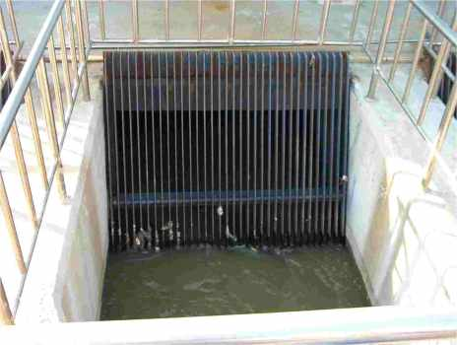
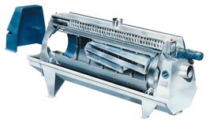
Preliminary Treatment
Screening
Mechanical
Bar Screens
Manual Bar Screens
Fine Screens

Slide 21
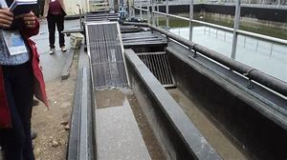

Slide 22
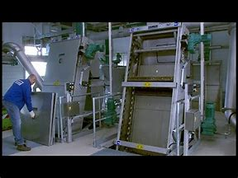

Slide 23
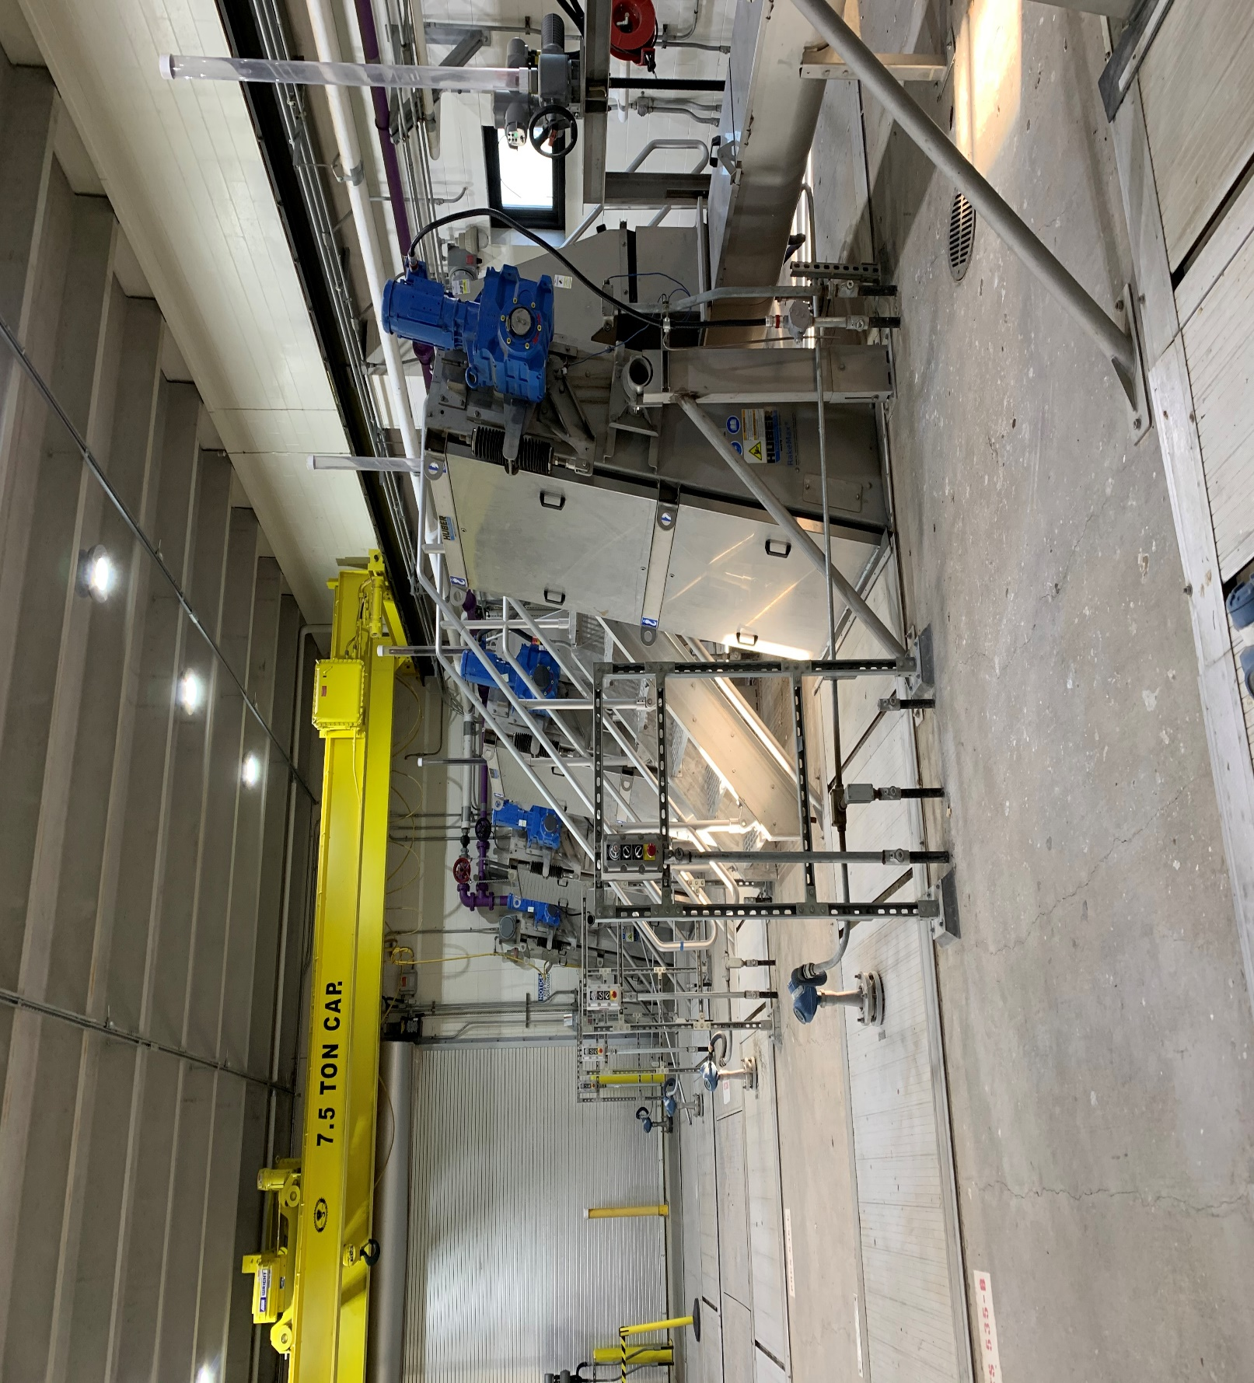

Slide 24
What are some of the safety issues?
Safety boots
Gloves
Hardhat if working with crane or if required
Moving parts
Raw Sewage
Keep your mouth closed
Wear safety glasses

Slide 25
Grit Removal

Slide 26
Kinds of Grit Removal
Open Grit Channel
Vortex Grit System
Conex Grit System
Aerated Grit System

Slide 27
How do they work?
What are the requirements for grit removal?
For open grit channel what will the flow need to drop down to? This will be on your test!!!
For an Aerated grit system, does the air reduce the density? Let’s talk.
There are other systems that do a much better job.

Slide 28
Grit systems that are of a Conical based system.

Slide 29
Open Grit Channel

Slide 30
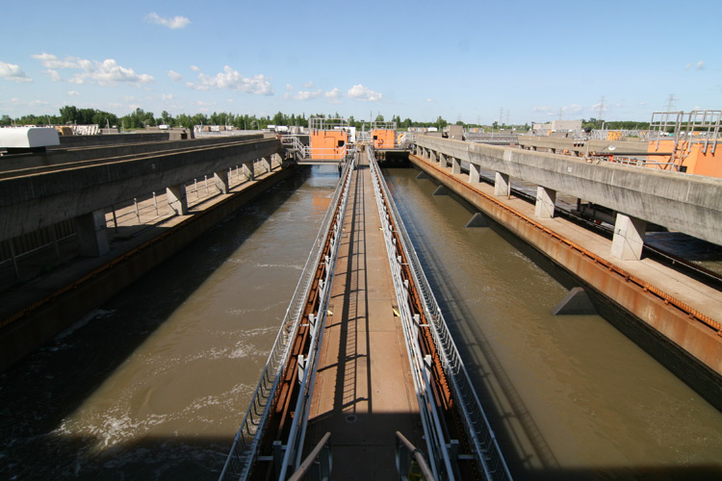

Slide 31
Primary Sedimentation

Slide 32
Primary sedimentation is usually the second stage of the Wastewater Treatment (WWT) process. It occurs after the water passes through the Inlet Works/Screening process where all non-organic solids such as non-dissolved materials, wet-pipes and debris are removed from the water.

Slide 33
Once wastewater leaves the Inlet Works/Screening process, organic solids remain in it. The rate of wastewater flow is reduced dramatically before entry into the primary sedimentation tanks; this has two effects on the wastewater:

Slide 34
1. Fats, oil and greases (commonly known as FOG) float to the surface of the sedimentation tank are collected by a scraper bar which continuously rotates across the surface of the tank. The FOG is removed from the wastewater and disposed of or sent to a Anerobic Digester.

Slide 35
2. Organic solids are heavier than water, and due to the effects of gravity, fall to the bottom of the tank. Once they reach the bottom of the tank, the sediment (often referred to as sludge) is collected by a rake arm and moved to a nearby storage tank (similar process as point (1) above).

Slide 36
At this stage, the sediment is a concentrated mix of water solids with a high content of HS2, methane and bacteria - this is where the sludge reprocessing process begins. The wastewater (now virtually solid free and considerably cleaner) enters the aeration stage of the process where small organic particles (too small to be affected by gravitation in the sediment tanks) and ammonia are removed.

Slide 37
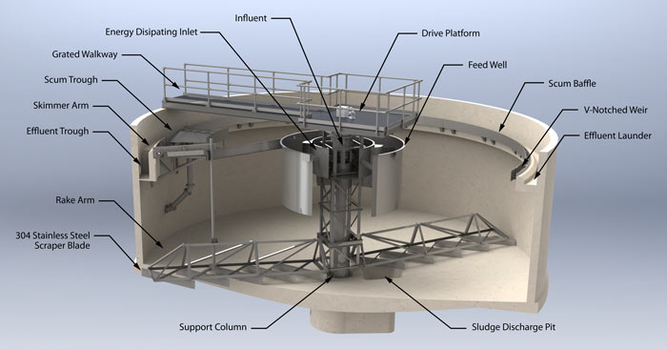

Slide 38
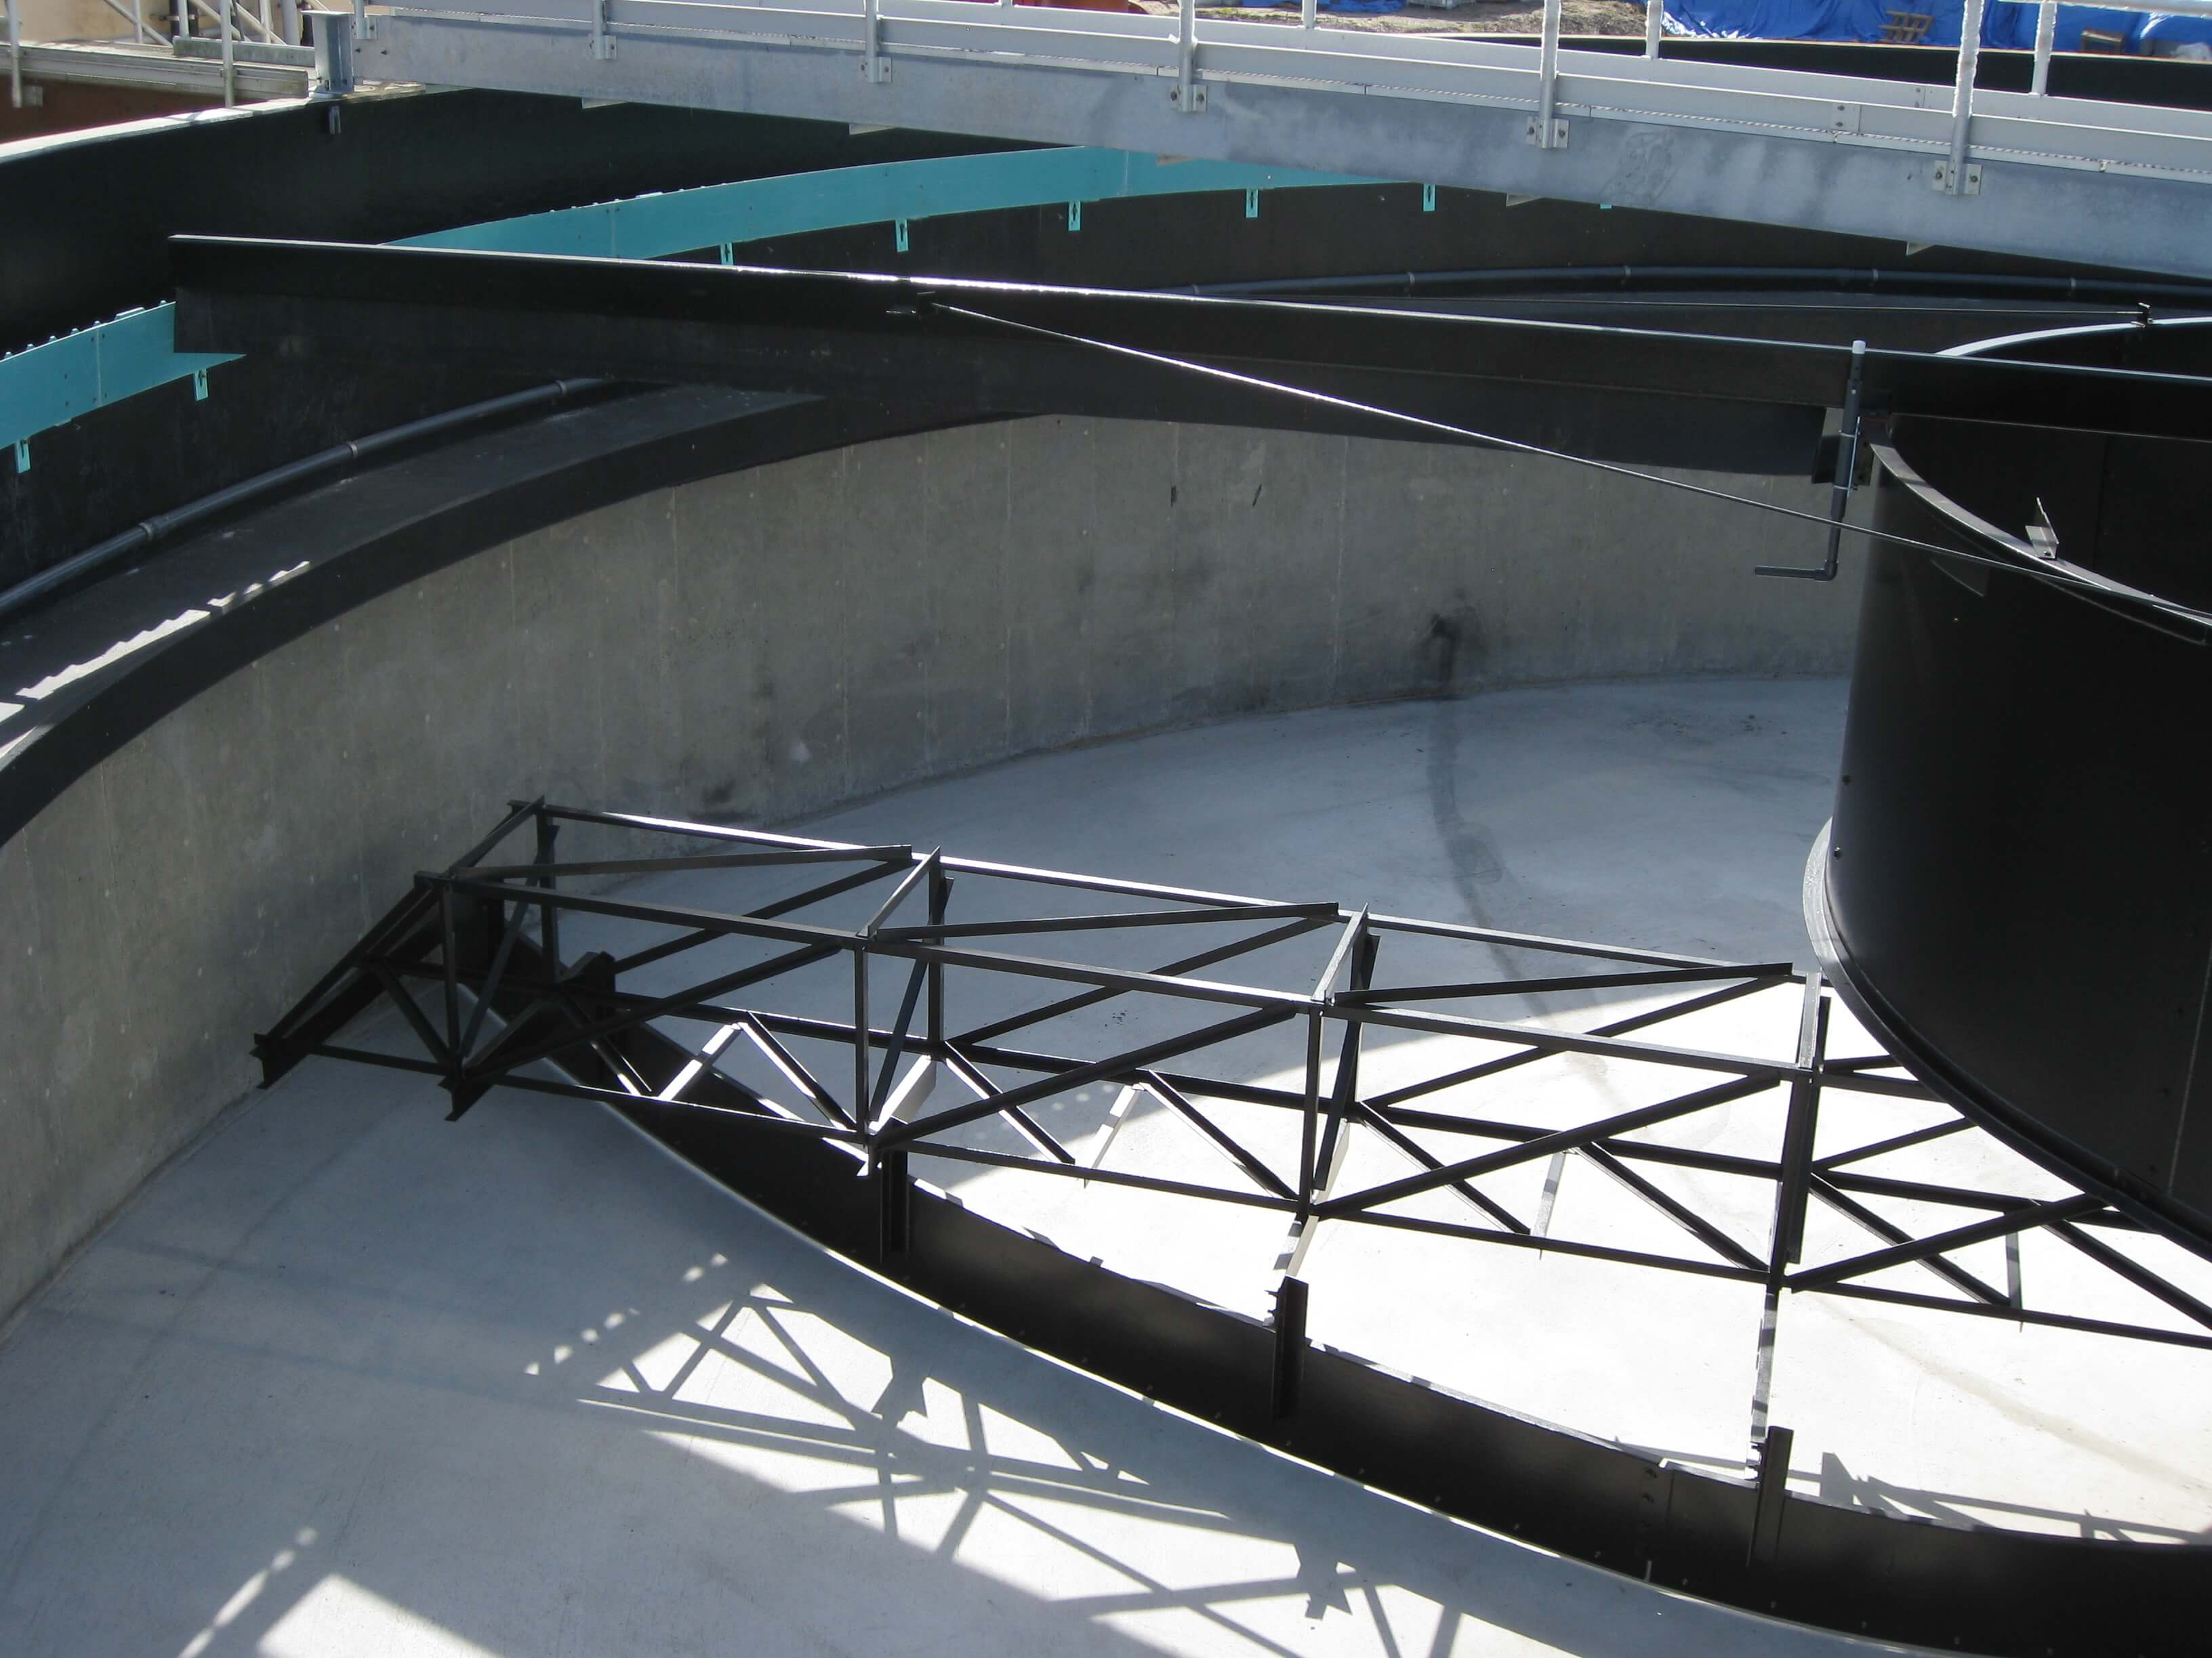

Slide 39
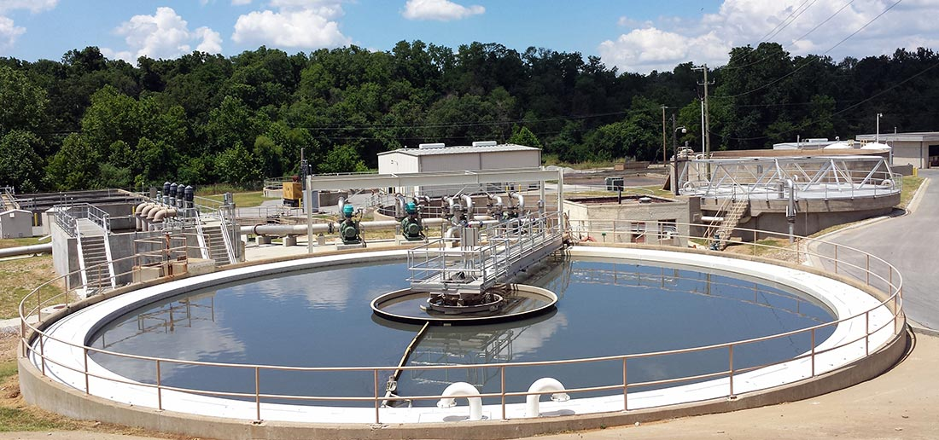

Slide 40
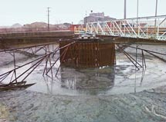

Slide 41
Most of the sedimentation process is of mechanical nature, however throughout the various stages of wastewater treatment, the aim is to keep the wastewater moving (at various speeds) from the beginning to the end of the process.
Still, some portions of the water remain in a static state and can cause a build-up of solids that create blockages and sedimentation problems for the mechanical equipment used in the treatment process.

Slide 42
To alleviate this, small amounts of air are introduced into the process to move the water along with mechanical surfaces or submerged mixers. In some cases, chemical dosing is also used to help break down the sludge.

Slide 43
What are the Benefits of Primary Sedimentation?
It is essential that the primary sedimentation process is maintained and operated to a high standard using reliable equipment. A poorly maintained primary sedimentation system can have a significant impact on the efficiency and life cycle of the treatment facility.

Slide 44
Safety Issues
What kind of safety issues can you think of?
Handrails
Protective covers
PPE needed
Sampling
DOBs

Slide 45
Thank you for your time.
Good luck on your exams
Go with your first answer unless you know that it should be changed
Lyman.waller@smaoperations.com
505-331-8132

